Slide 1
One Class SVM
One-Class SVM is an unsupervised machine learning algorithm used mainly for:
Anomaly Detection
Outlier Detection
Novelty Detection
Instead of learning two classes (0 and 1) like normal SVM, it learns only one class (normal data) and detects whether a new data point is similar or different from that class.

Slide 2
Classification problems are often solved using supervised learning algorithms such as
Random Forest Classifier, Support Vector Machine, Logistic Regressor (for binary class
classification) etc.
A specific type of binary classification problem with single class training examples is called One-Class Classification (OCC). One-Class Classification is solved using an unsupervised or semi-supervised learning algorithm such as One-Class Support Vector Machines (1-SVM),Support Vector Data Description (SVDD) etc.
One of the popular examples of One-Class Classification is Anamoly Detection (AD) i.e.,
outlier detection and novelty detection. So, it is dealing with class imbalance.

Slide 3
The One-Class Support Vector Machine (SVM) is a variant of the traditional SVM. It is
specifically tailored to detect anomalies. Its primary aim is to locate instances that notably deviate from the standard.
Unlike conventional machine learning models focused on binary or multiclass classification, the one-class SVM specializes in outlier or novelty detection within datasets.

Slide 4
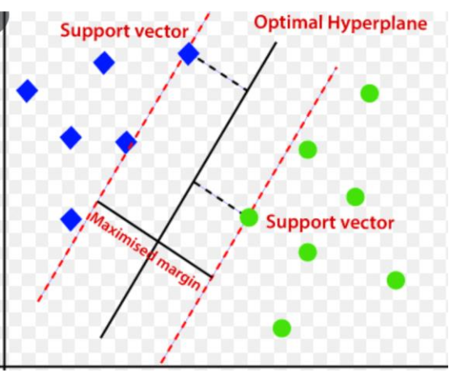
SVMs work by finding the optimal hyperplane that separates different classes in feature space while maximizing the margin between them. This hyperplane is based on a subset of training data points called support vectors.

Slide 5
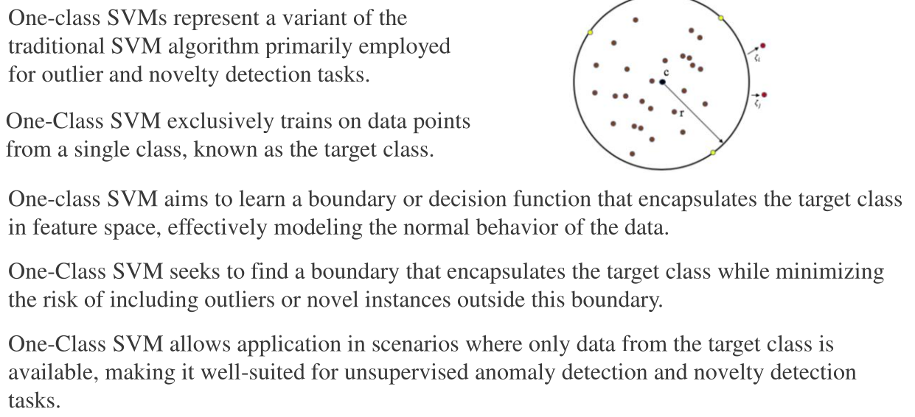

Slide 6
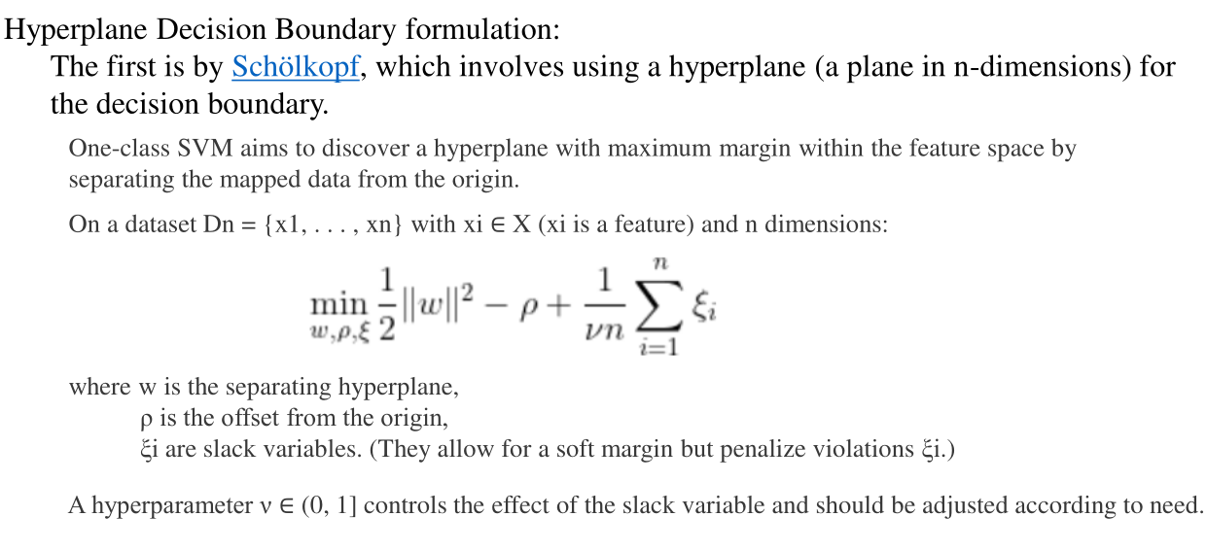

Slide 7
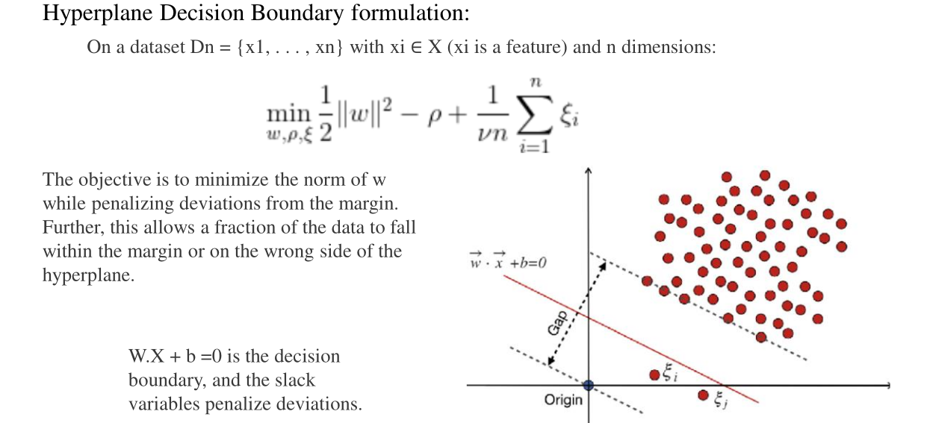

Slide 8
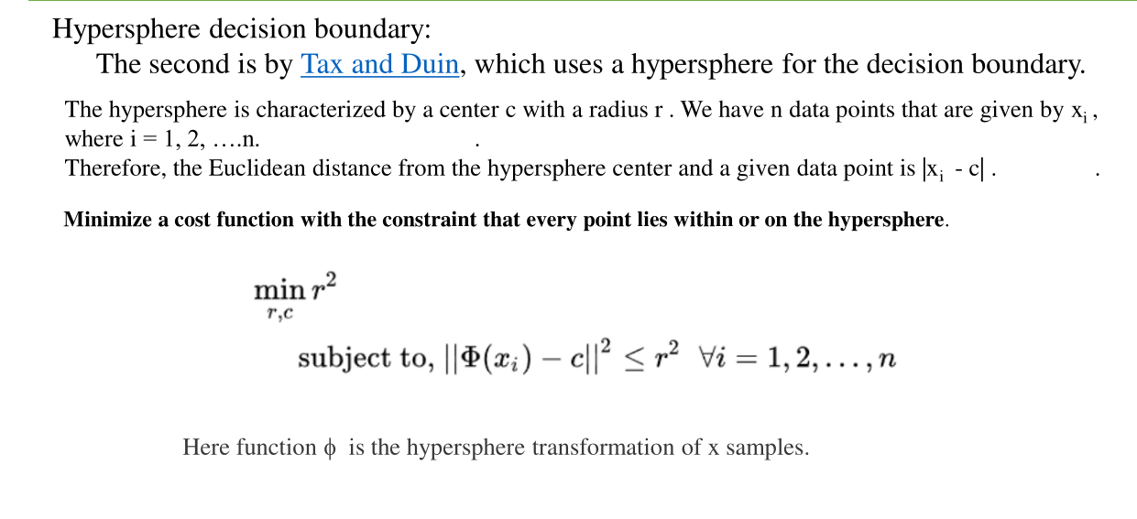

Slide 9
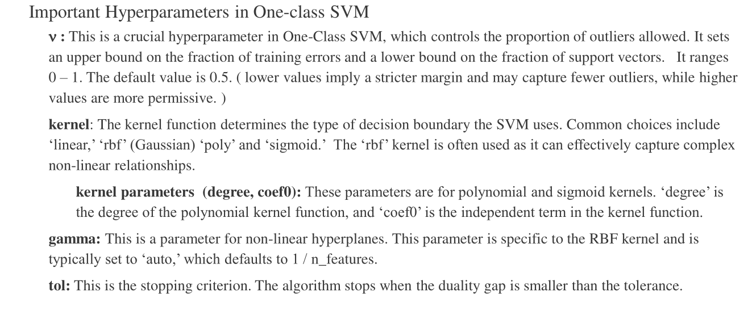

Slide 10
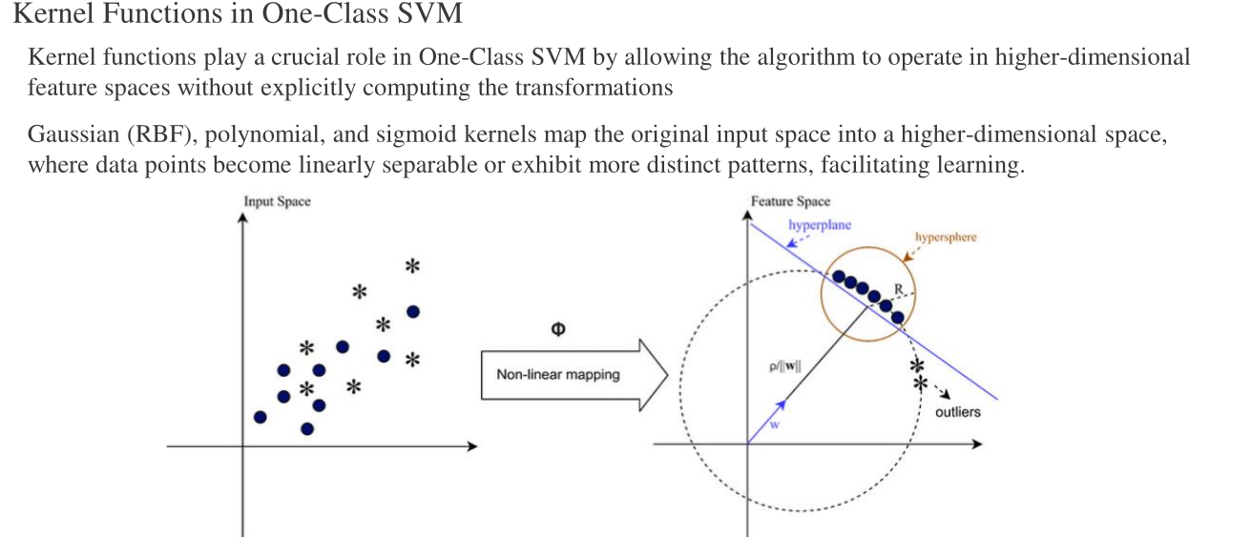

Slide 11
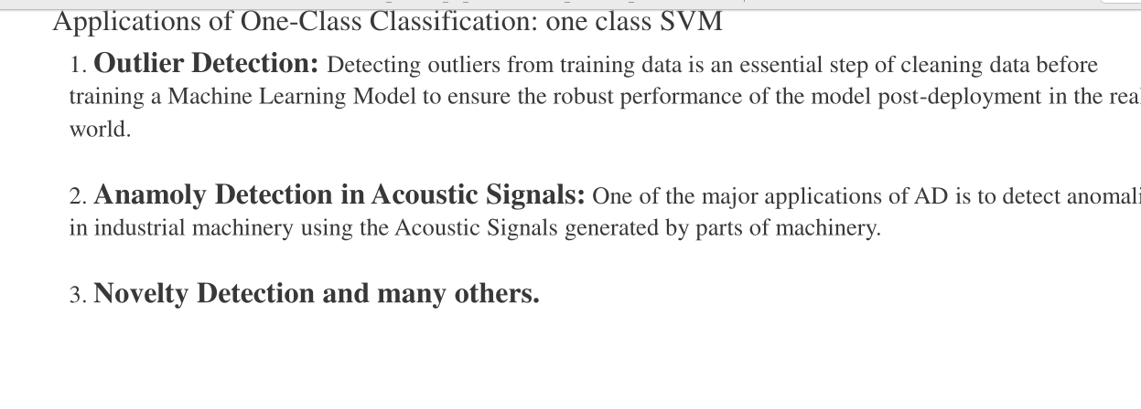

Slide 12
Optimize Hyperparameters
Hyperparameter optimization means finding the best values of parameters that control the learning process of a model so that the model performs better.
Hyperparameters control how the model learns.

Slide 13
Correct hyperparameters help to:
Improve model accuracy
Reduce overfitting
Reduce underfitting
Improve generalization

Slide 14
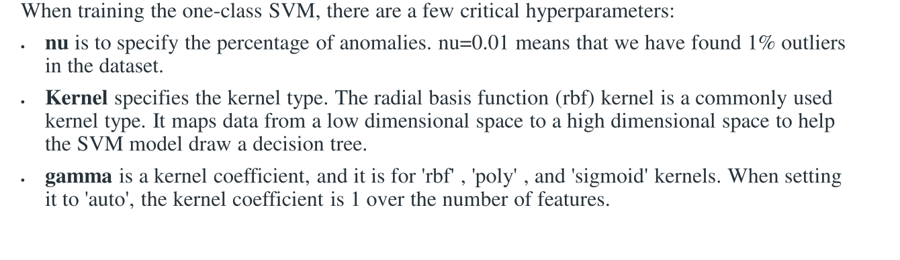

Slide 15
Techniques like grid or random search
cross-validation to find the optimal values.

Slide 16
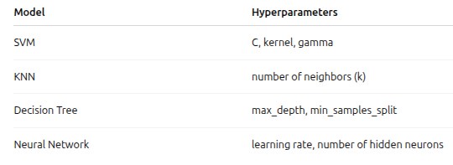
Example

